Slide 1


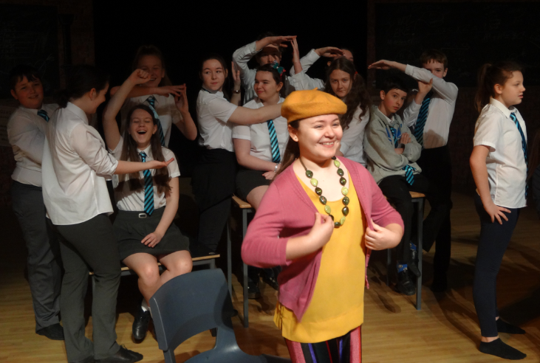
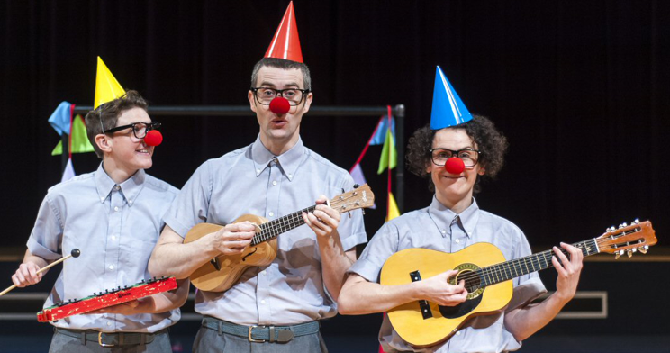
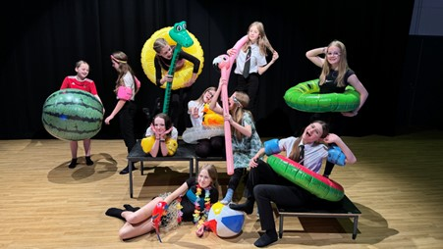
Bridging Work
See at least three pieces of theatre live or live on screen
Create a complication of theatre reviews for at least one of these, preferably all of them
Get fitter
Read at least one play – if it could be Home I,m Darling, The Arsonists or The Book of Dust, brilliant. But any play.
Optional: Create a fact file with images on Stanislavski, Brecht and Emma Rice

